Slide 1
Unsupervised Machine Learning
involves training algorithms on data without explicitly providing labeled outcomes or targets.
The goal is to identify patterns, relationships, or structures within the data. Here are some common types and techniques in unsupervised machine learning:
Clustering:
  K-Means: Partitions the data into K clusters by minimizing the variance within each cluster.
  Hierarchical Clustering: Builds a tree of clusters through agglomerative (bottom-up) or divisive (top-down) approaches.
  DBSCAN (Density-Based Spatial Clustering of Applications with Noise): Identifies clusters based on density, useful for finding arbitrarily shaped clusters.
Dimensionality Reduction:
  Principal Component Analysis (PCA): Transforms data into a set of orthogonal components that maximize variance.
  t-Distributed Stochastic Neighbor Embedding (t-SNE): Reduces dimensions for visualization, preserving local relationships.
  Autoencoders: Neural networks that learn to compress and then reconstruct data, often used for feature learning and dimensionality reduction.

Slide 2
Unsupervised Machine Learning (self-study)
3- Association:
  a- Apriori Algorithm: Identifies frequent item sets and association rules in transactional databases.
  b- FP-Growth (Frequent Pattern Growth): More efficient than Apriori for mining frequent item sets.
4- Anomaly Detection:
  a- Isolation Forest: Identifies anomalies by randomly partitioning data and isolating outliers.
  b- One-Class SVM: Classifies data points as similar or different from the majority of the training set.
5- Self-Organizing Maps (SOMs):
Neural network models used for clustering and visualizing high-dimensional data by mapping input data into
a lower-dimensional (typically 2D) grid.

Slide 3
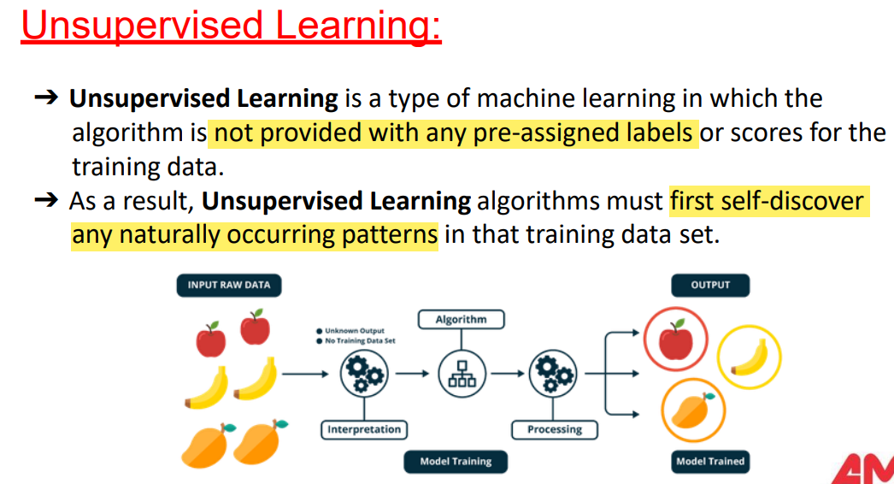

Slide 4
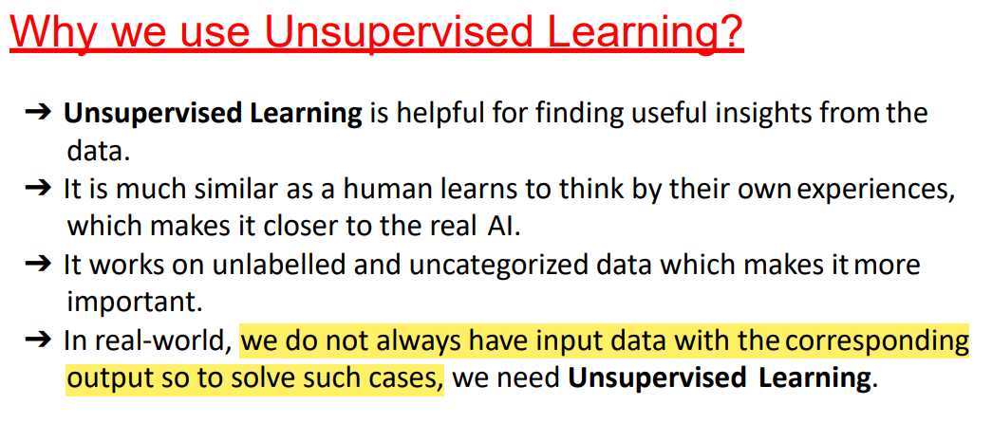

Slide 5
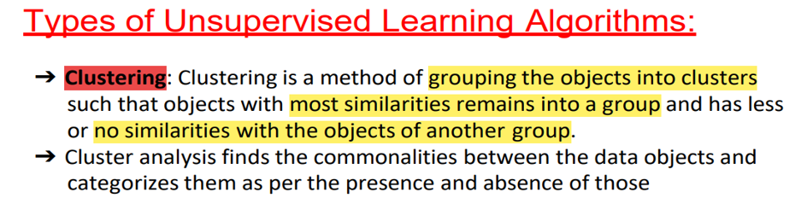
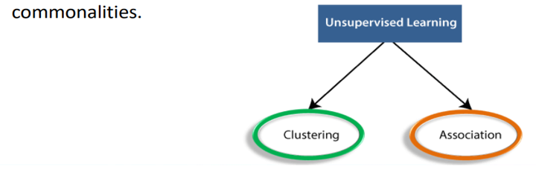

Slide 6
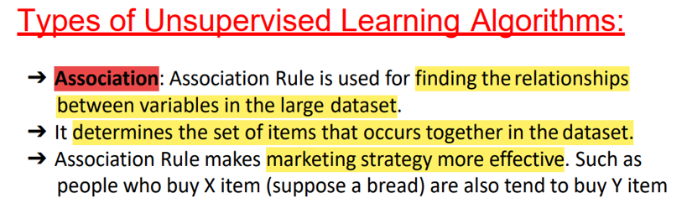
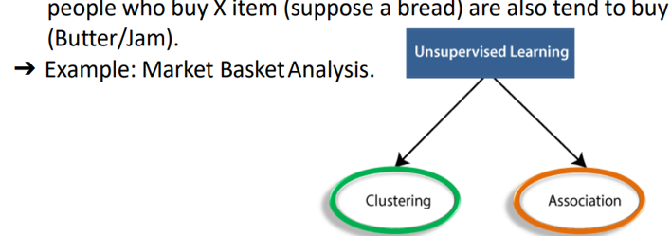

Slide 7
K-Means Clustering
  Algorithm:
    Choose k initial cluster centers randomly.
    Assign each data point to the nearest cluster center.
    Recalculate the cluster centers as the mean of all points in the cluster.
    Repeat steps 2 and 3 until the cluster assignments no longer change.
  Advantages: Simple and efficient for large datasets.
  Disadvantages: Requires specifying the number of clusters K beforehand, and it's sensitive to the initial choice of cluster centers.

Slide 8
Hierarchical Clustering
Algorithm:
  Agglomerative (Bottom-Up): Start with each data point as its own cluster and iteratively merge the closest pairs of clusters.
  Divisive (Top-Down): Start with all data points in a single cluster and recursively split the clusters.
Advantages: Does not require specifying the number of clusters K and produces a dendrogram that can help determine the optimal number of clusters.
Disadvantages: Computationally expensive for large datasets.

Slide 9
DBSCAN (Density-Based Spatial Clustering of Applications with Noise)
Algorithm:
  Classify points as core points, border points, or noise based on the density of neighboring points.
  Form clusters by connecting core points that are within a specified distance
  (ϵ \ epsilon) and include border points.
Advantages: Can find arbitrarily shaped clusters and handle noise effectively.
Disadvantages: Requires choosing parameters ϵ\epsilonϵ (distance) and minPts (minimum number of points), which can be difficult.

Slide 10
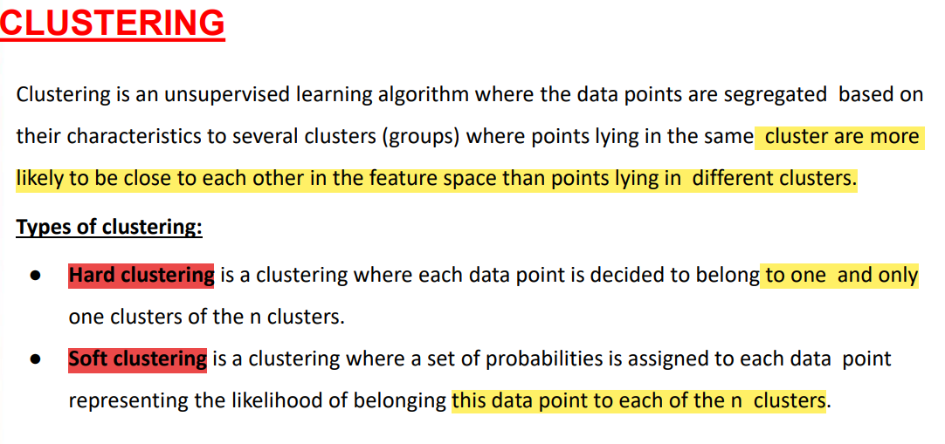
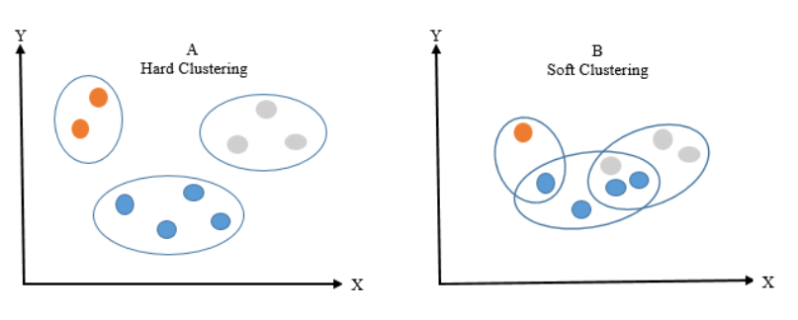

Slide 11
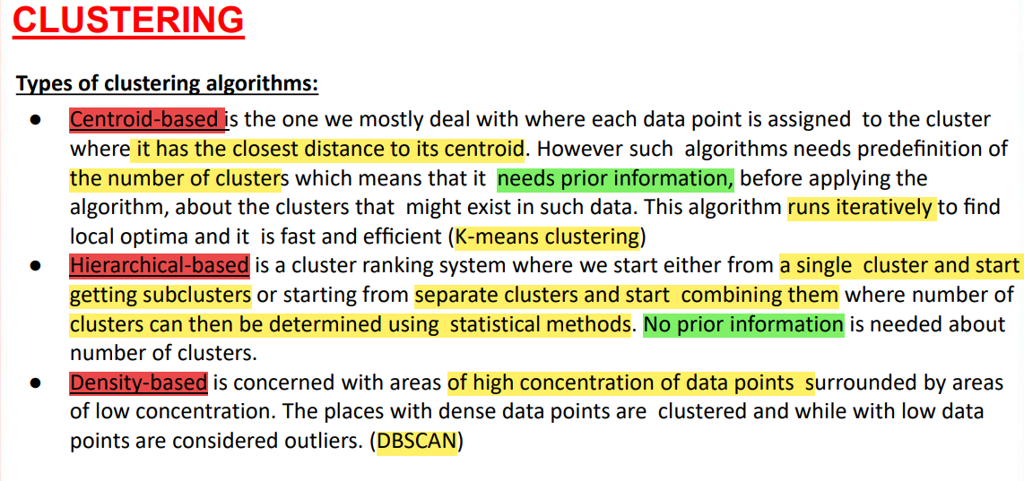

Slide 12
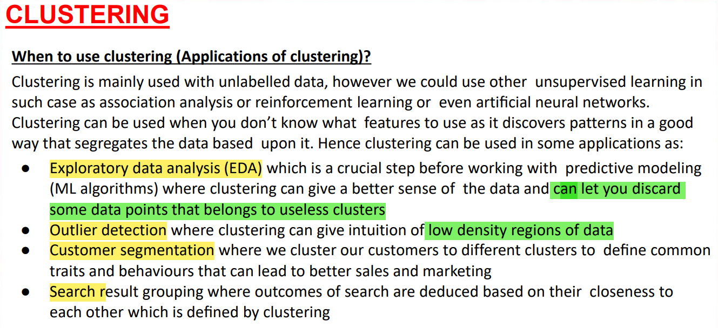
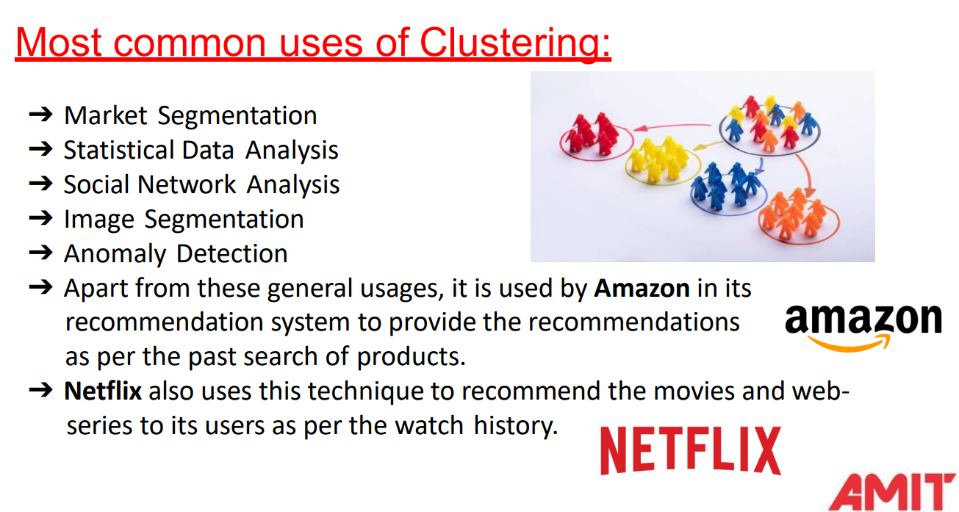

Slide 13
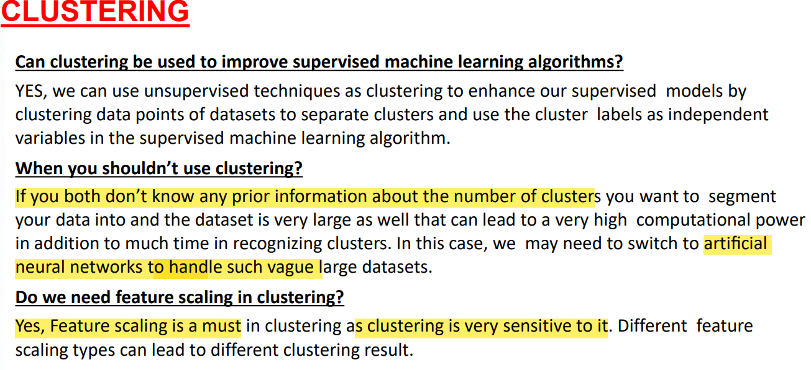

Slide 14
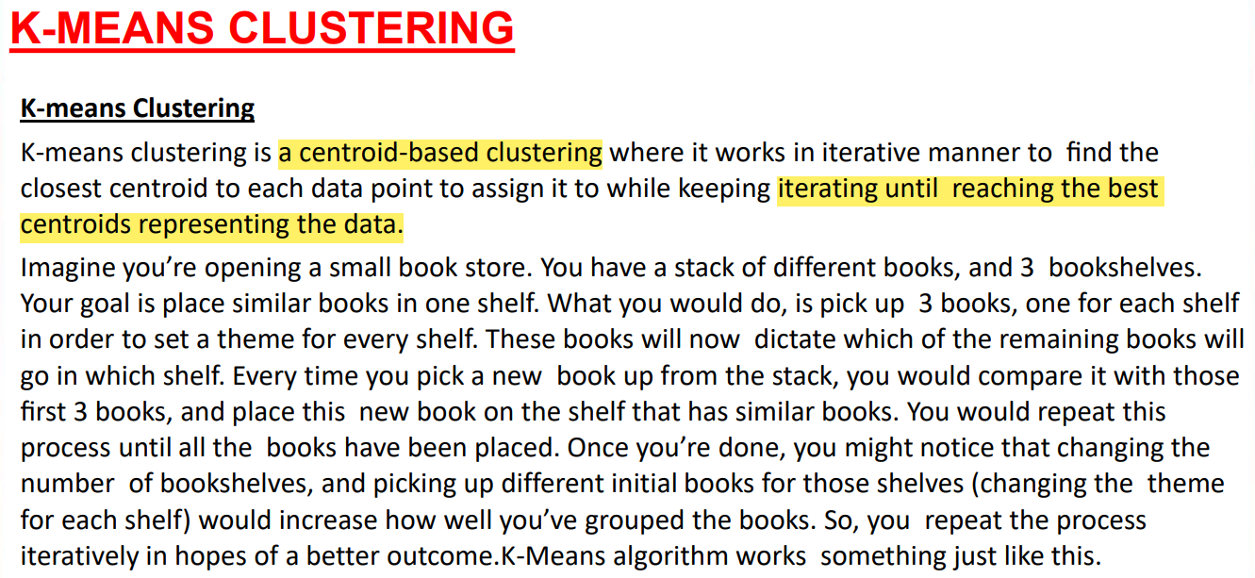

Slide 15
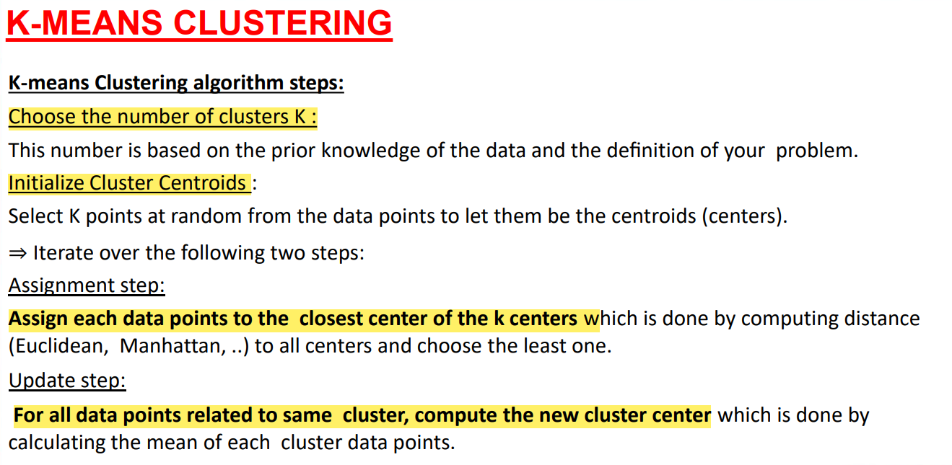
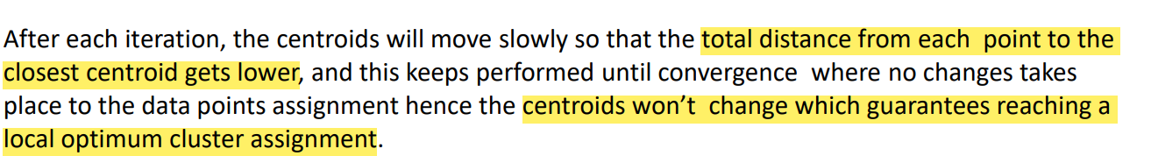

Slide 16
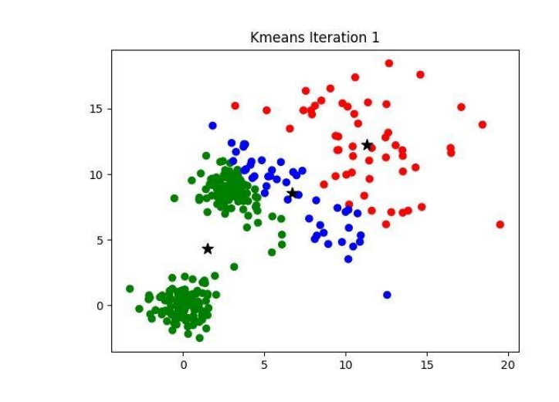

Slide 17
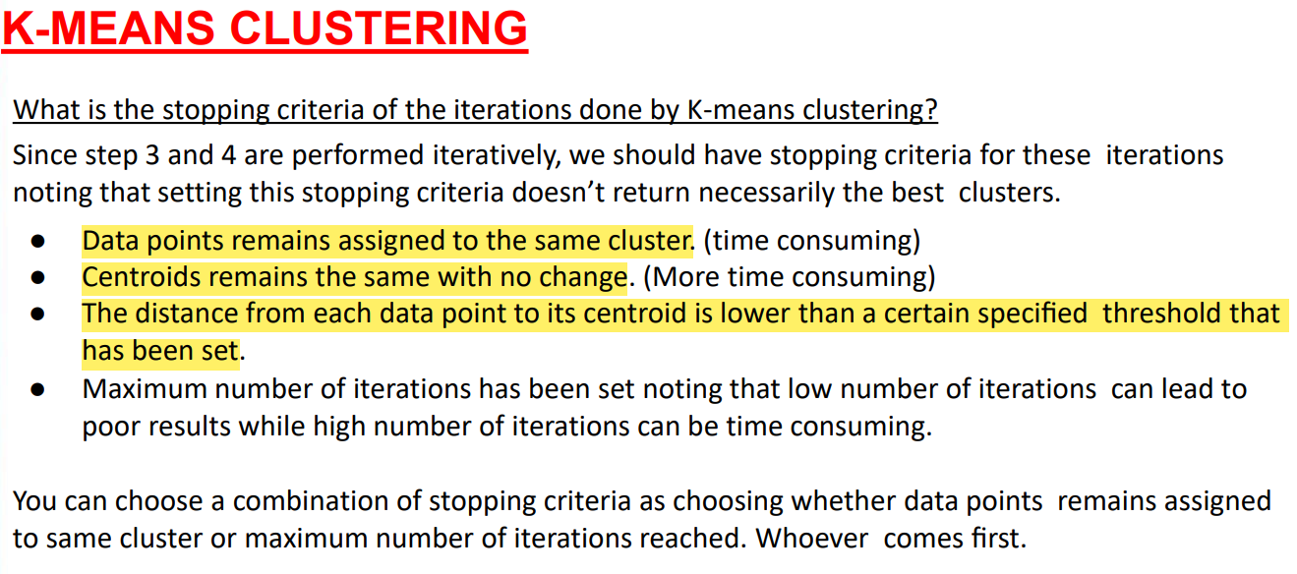

Slide 18
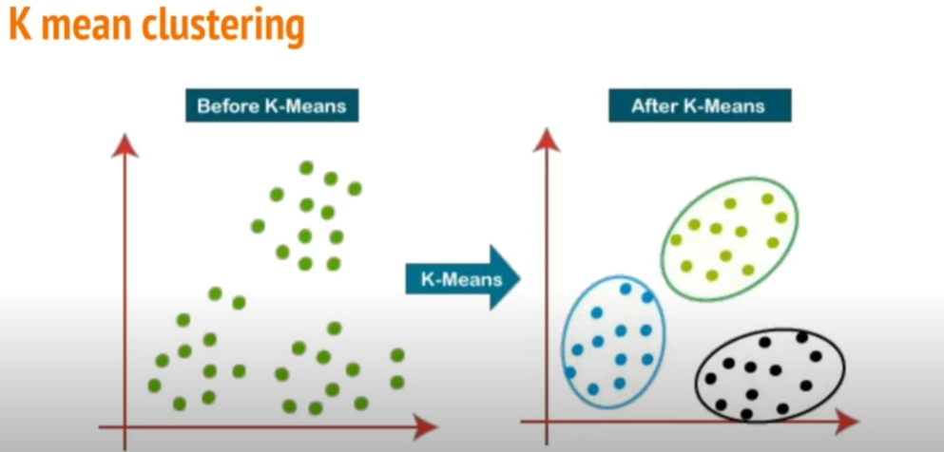
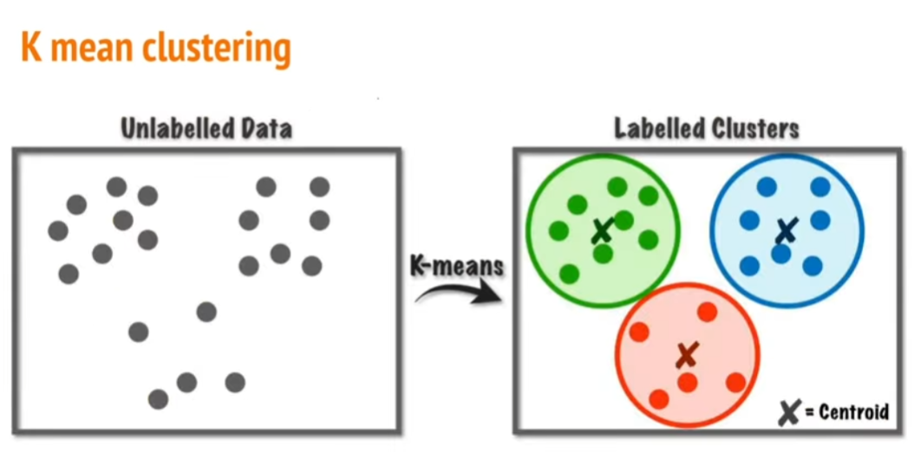
K means Clustering

Slide 19
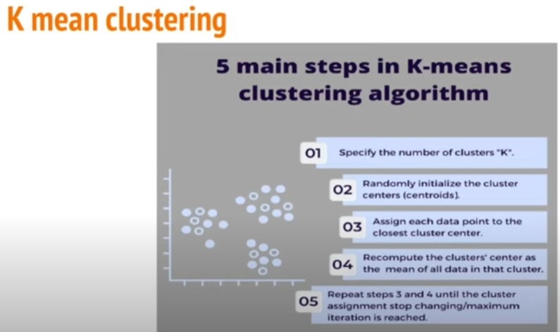
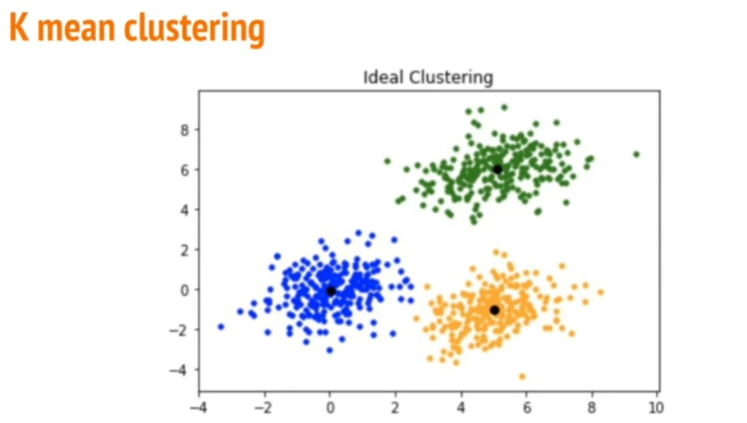
K means Clustering

Slide 20
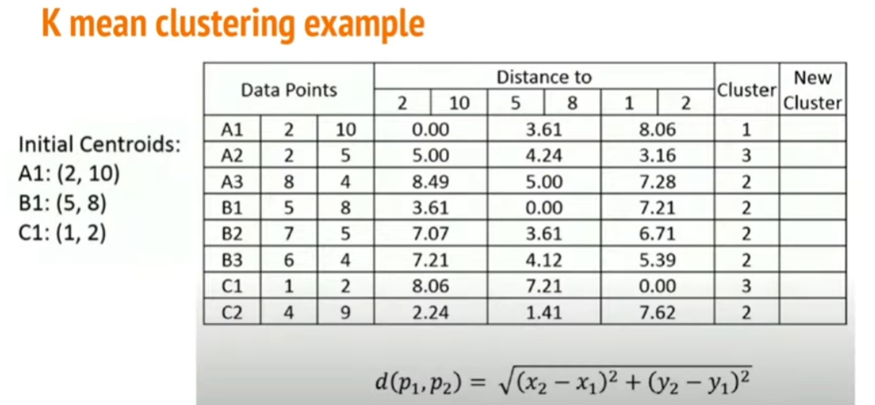
K means Clustering

Slide 21
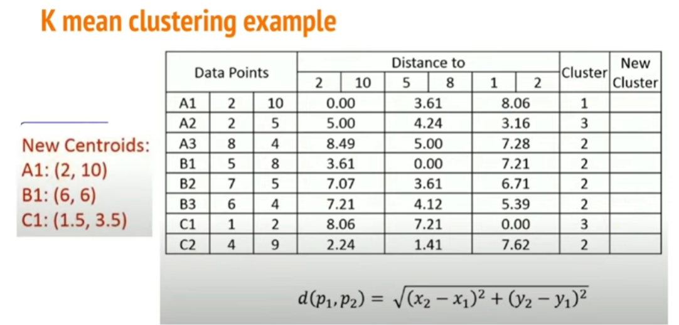
K means Clustering

Slide 22
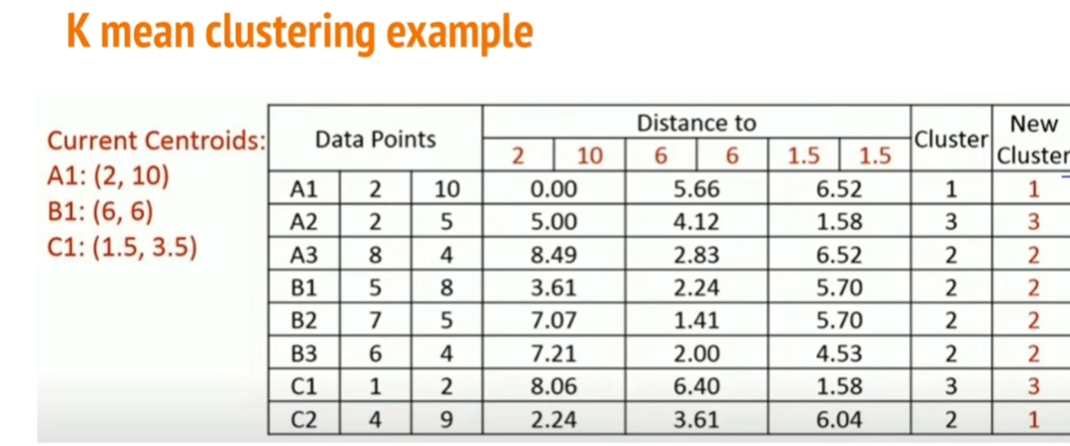
K means Clustering

Slide 23
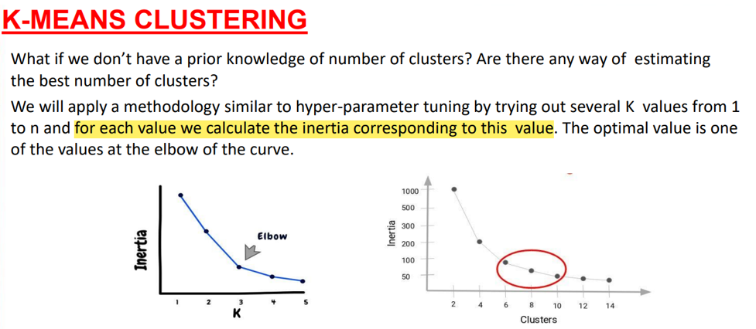

Slide 24
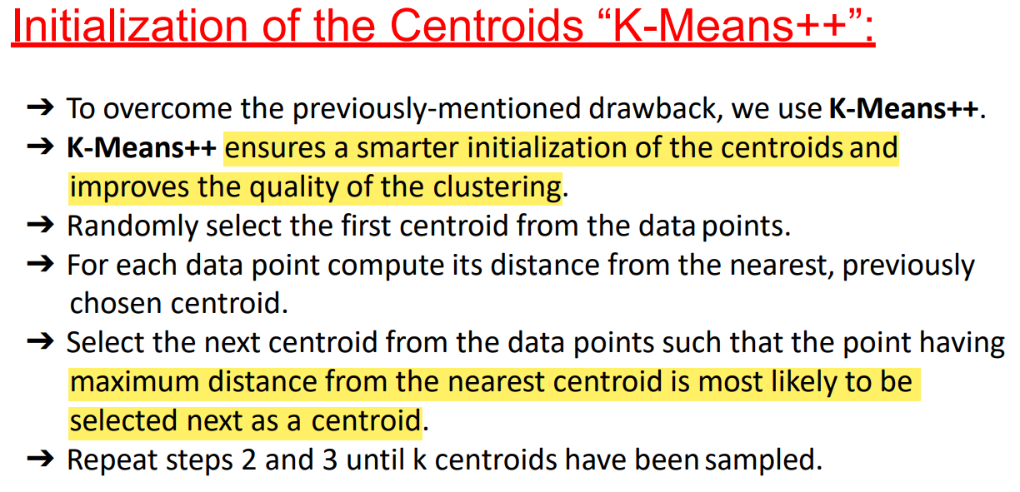
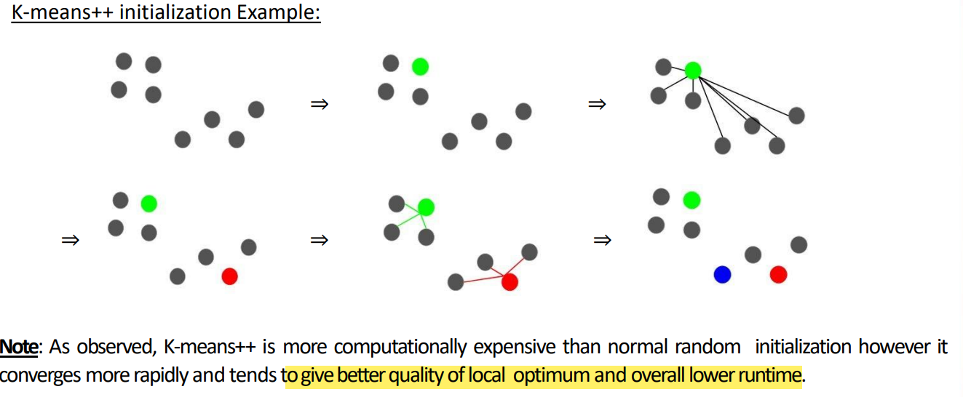

Slide 25
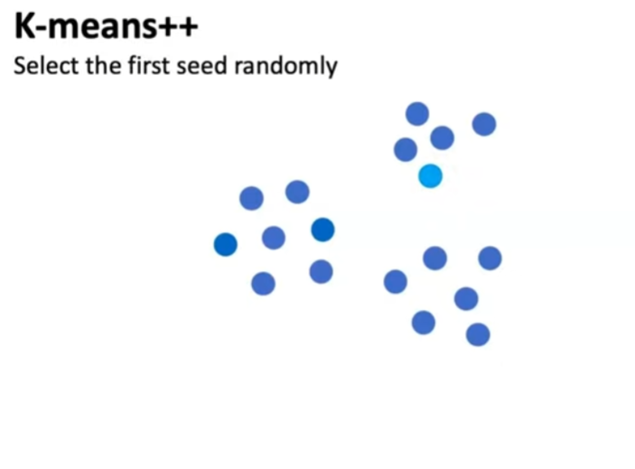
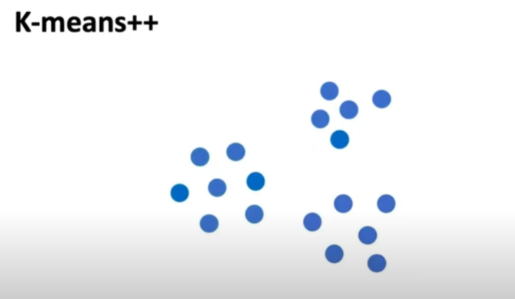
Kmeans++ how it works:

Slide 26
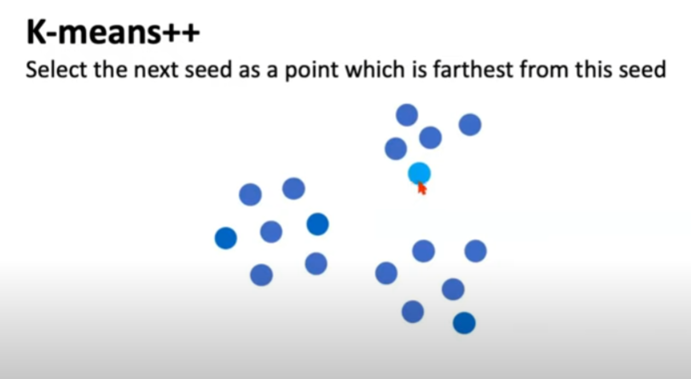
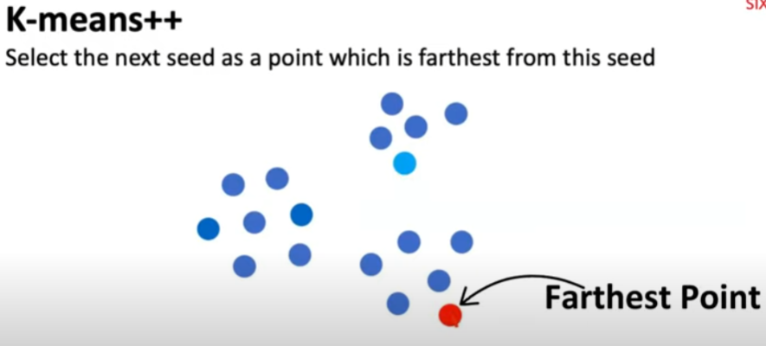
Kmeans++ how it works:

Slide 27
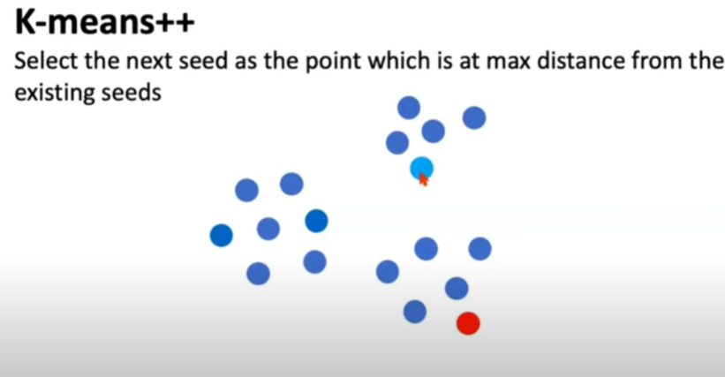
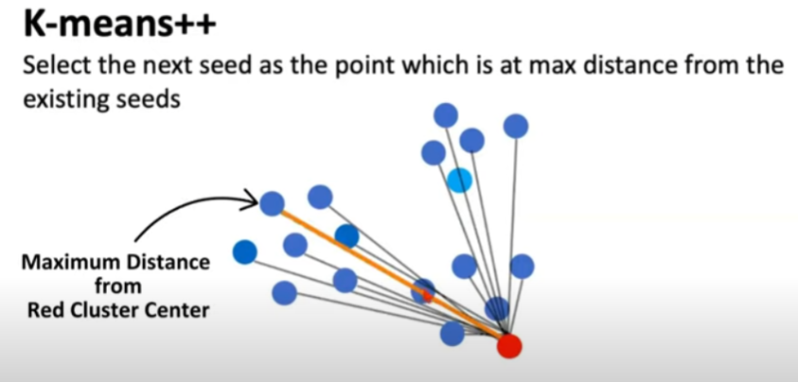
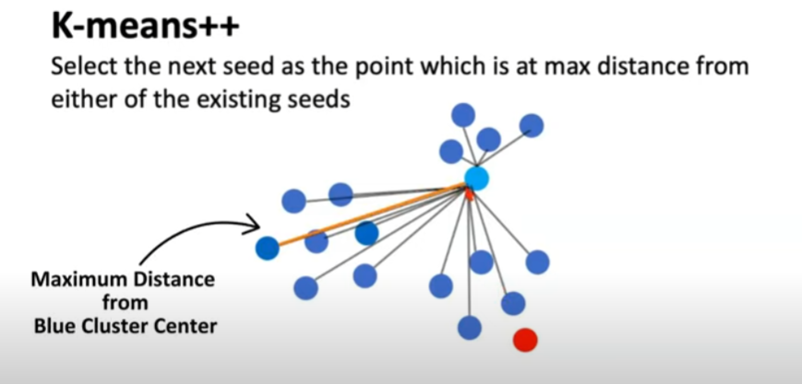
Kmeans++ how it works:

Slide 28
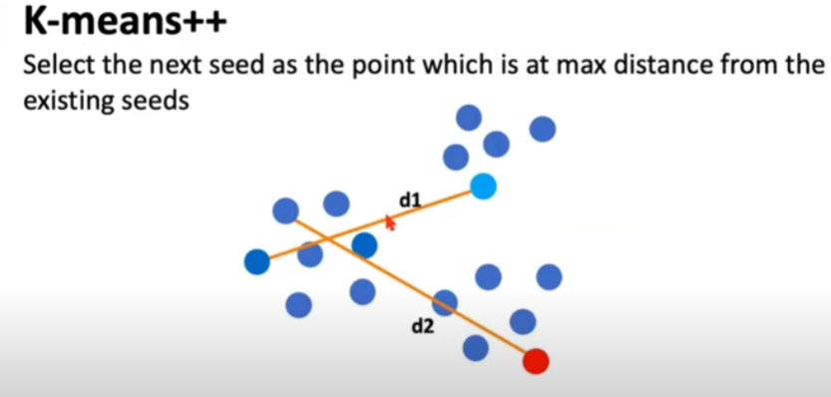
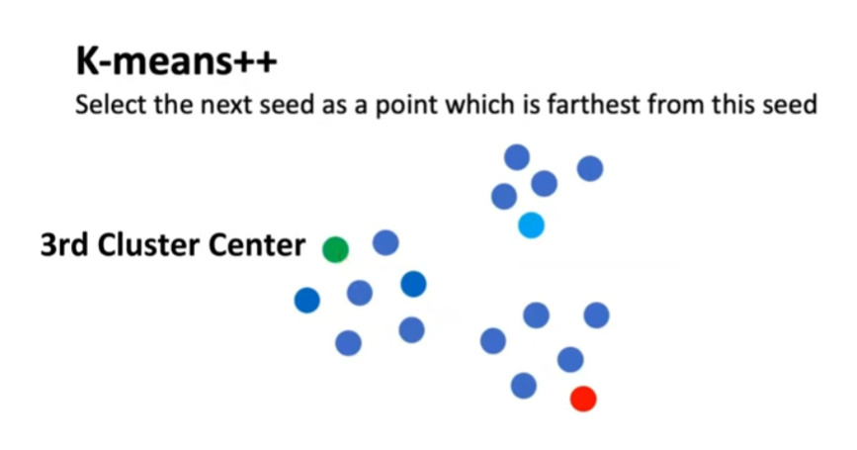
Kmeans++ how it works:

Slide 29
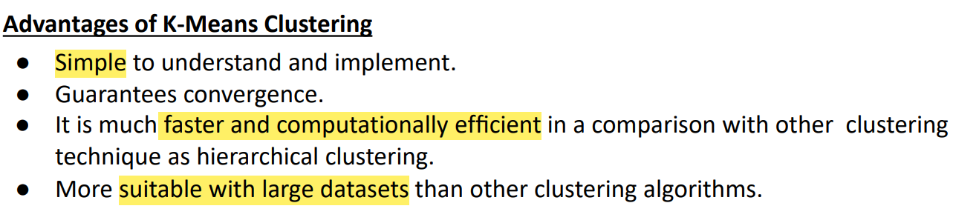
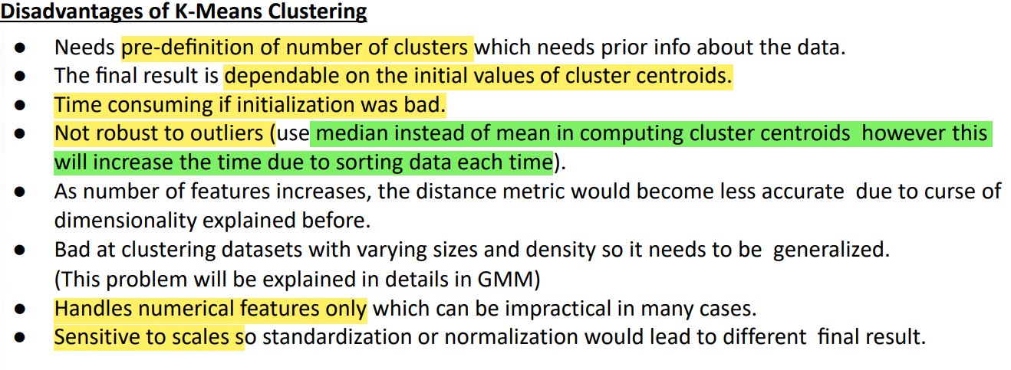

Slide 30
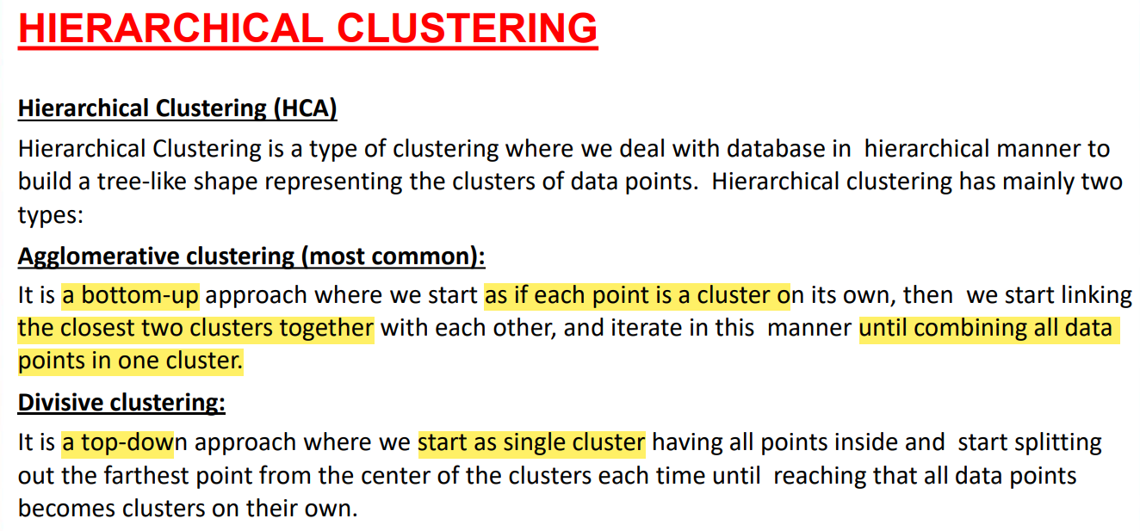

Slide 31
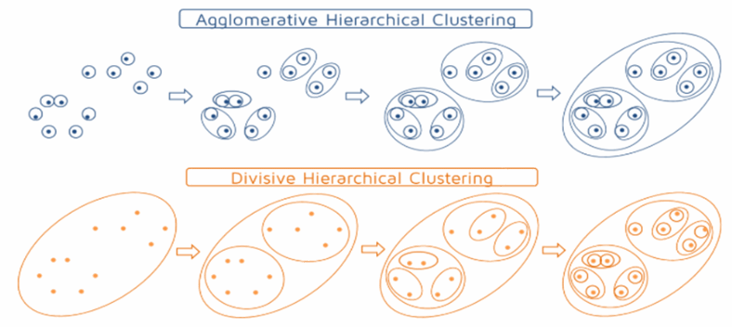

Slide 32
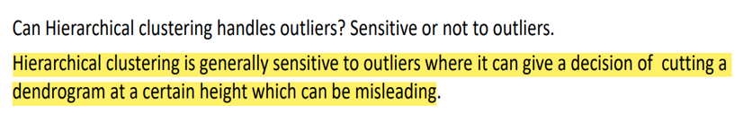
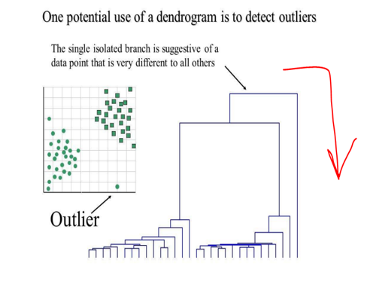

Slide 33
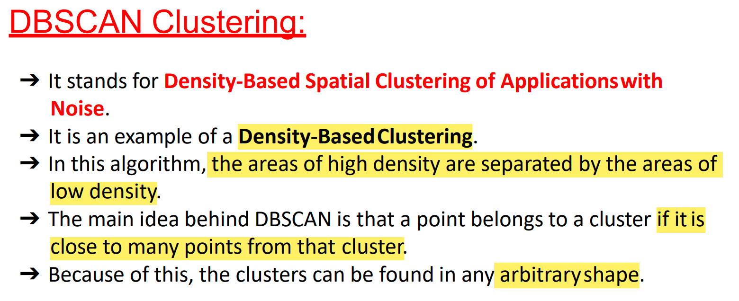

Slide 34
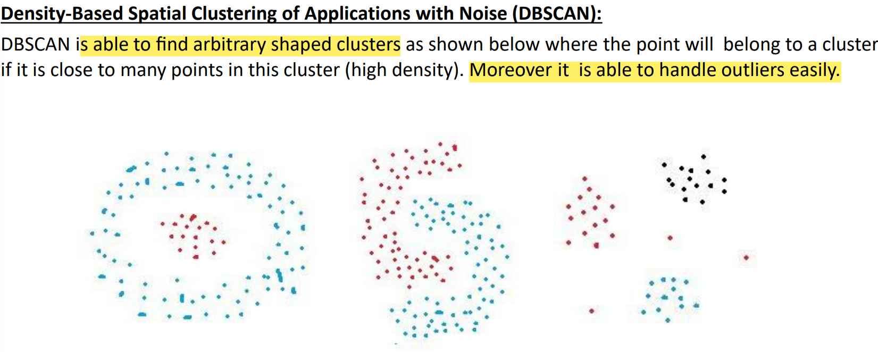

Slide 35
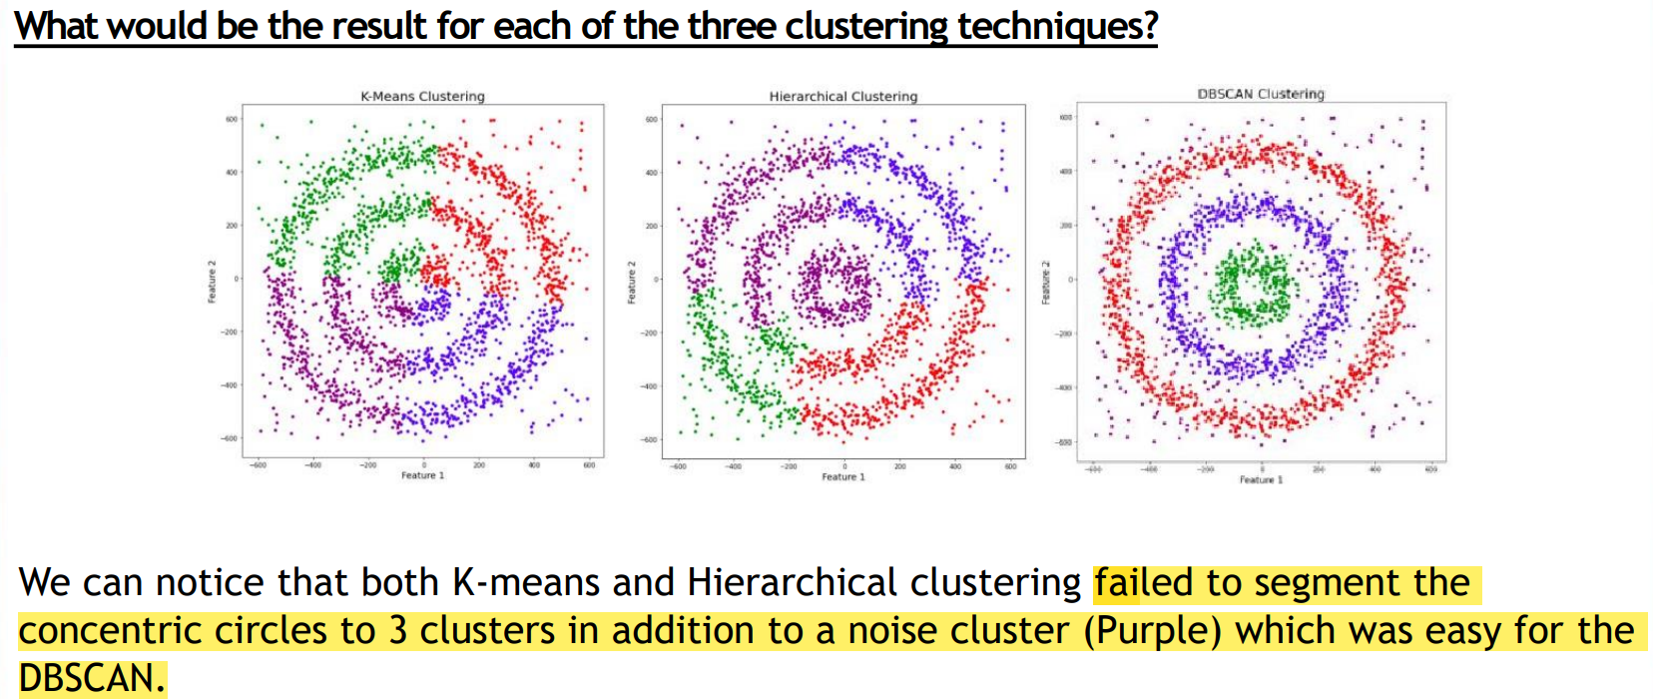

Slide 36
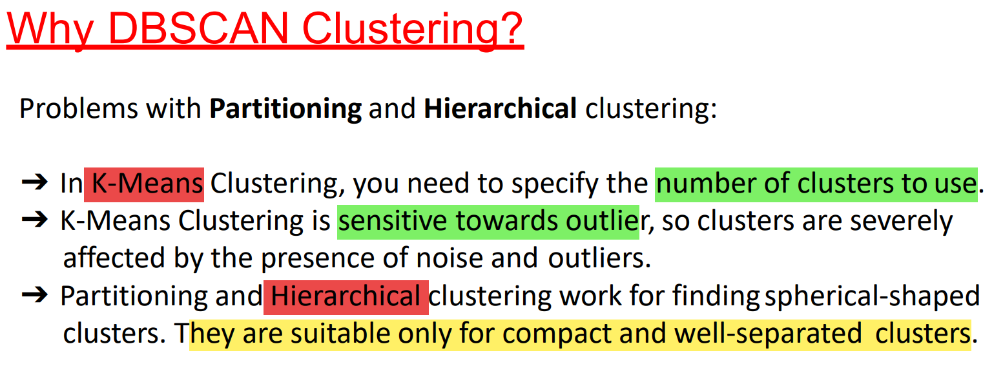
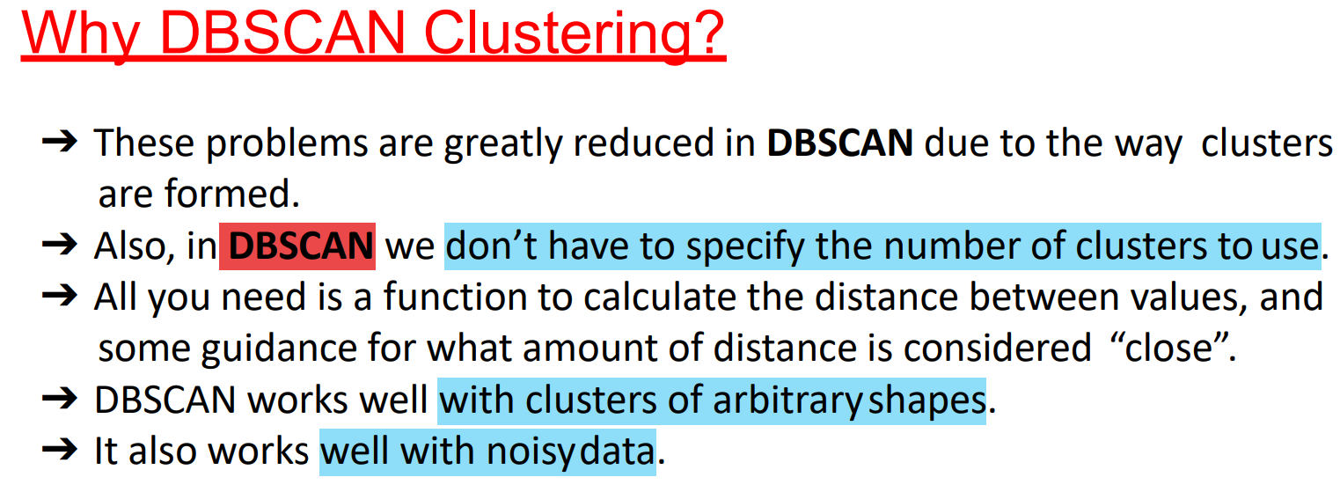

Slide 37
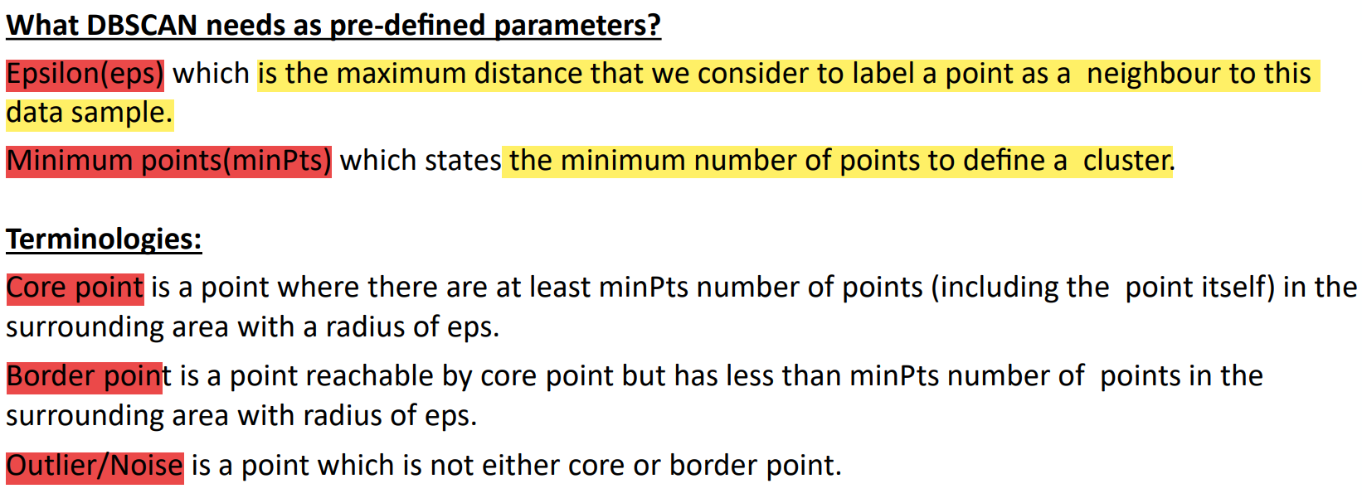
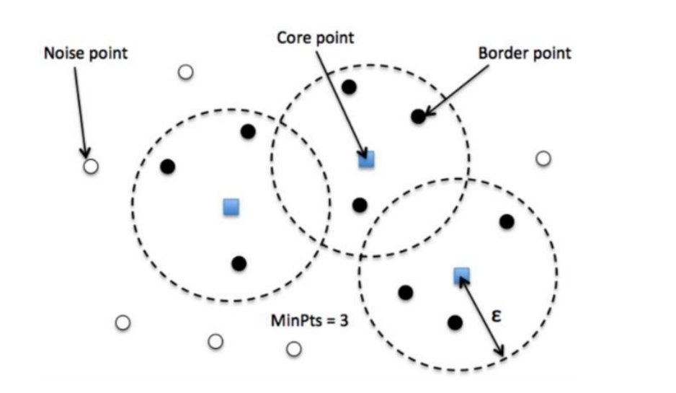

Slide 38
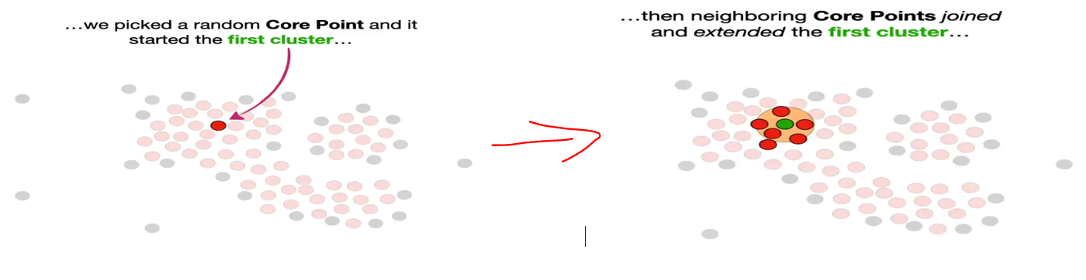


Slide 39


Slide 40


Slide 41


Slide 42


Slide 43


Slide 44


GMM (Gaussian Mixture model)

Slide 45

GMM

Slide 46


GMM

Slide 47


GMM

Slide 48


GMM

Slide 49


GMM

Slide 50

GMM

